Slide 1
DATA STRUCTURES
BY-
PRIYANKA CHAUDHARY
ENAKSHI
SALONI JINDAL

Slide 2
INTRODUCTION TO SORTING
Sorting of data means arranging it in a certain order, often in an array-like structure. We can use various ordering criterias, like sorting numbers from least to greatest or vice-versa, or sorting strings.
Given a user input we need to find a permutation such that the set is sorted in increasing or decreasing order, numercically or alphabetically.

Slide 3
TYPES OF SORTING
Various types of sorting are:-
Bubble Sort
Insertion Sort
Selection Sort

Slide 4
BUBBLE SORT
Bubble sort works by swapping adjacent elements if they're not in the desired order. This process repeats from the beginning of the array until all elements are in order.

Slide 5
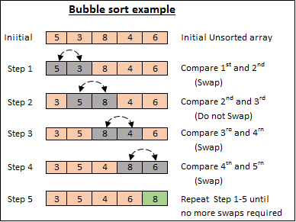
BUBBLE SORT ALGORITHM
Following are the steps involved in bubble sort(for sorting a given array in ascending order):
Starting with the first element(index = 0), compare the current element with the next element of the array.
If the current element is greater than the next element of the array, swap them.
If the current element is less than the next element, move to the next element.
Repeat Step 1.

Slide 6
BUBBLE SORT CODE
Code for the figure in the previous slide:-
for(int i=0;i<n;i++){
for(int j=i;j<n-i-1;j++){
if(a[j]>a[j+1]){
swap(a[j],a[j+1]);
}
}
}
for(int i=0;i<n;i++){
System.out.print(a[i]);
}

Slide 7
INSERTION SORT
Insertion sort is based on the concept, when one element from the input elements is used in each iteration to find its correct position i.e, the position to which it belongs in a sorted array.
It compares the current element with the largest value in the sorted array.

Slide 8
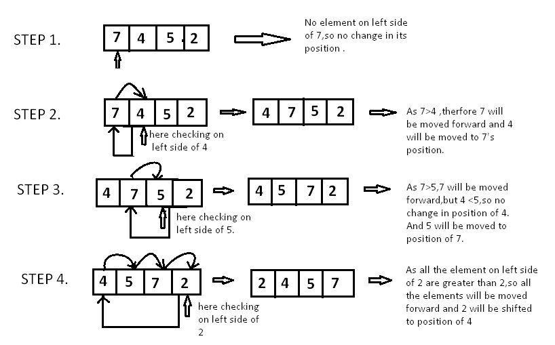
INSERTION SORT ALGORITHM
Following are the steps involved in insertion sort:
Firstly the second element of the array, i.e. element at index 1,is considered as the key.
The key is the new element here that we need to add to our existing sorted set of elements
We compare the key element with the element(s) before it, in this case, element at index 0:
If the key element is less than the first element, we insert the key element before the first element.
If the key element is greater than the first element, then we insert it after the first element.
4. Then, we make the third element of the array as key and will compare it with elements to it's left and insert it at the right position.
5. And we go on repeating this, until the array is sorted.

Slide 9
INSERTION SORT CODE
Code for the figure in the previous slide:-
for(int i=0;i<n;i++){
while(int j<=0 && key<arr[j]){
arr[j+1]=arr[j];
j--;
}
arr[j+1]=key;
}
for(int i=0;i<n;i++){
System.out.print(arr[i]);
}

Slide 10
SELECTION SORT
The selection sort algorithm sorts an array by repeatedly finding the minimum element (considering ascending order) from unsorted part and putting it at the beginning. The algorithm maintains two subarrays in a given array.
The subarray which is already sorted.
Remaining subarray which is unsorted.

Slide 11
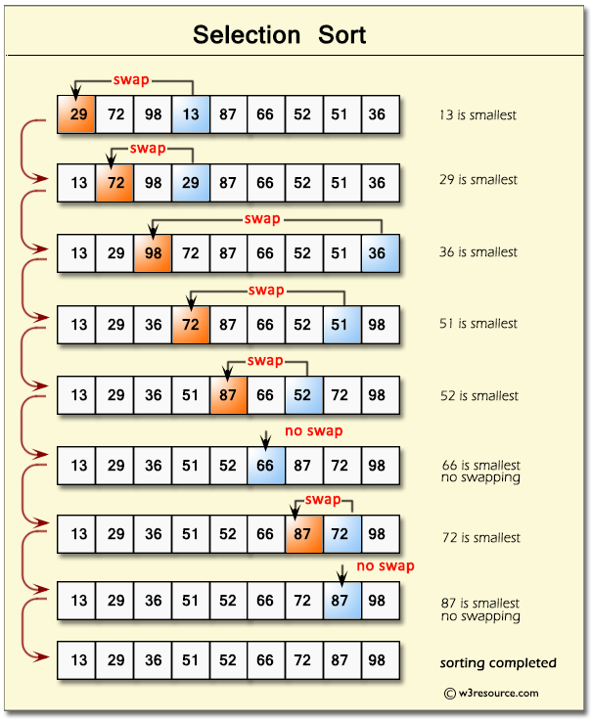
SELECTION SORT ALGORITHM
Following are the steps involved in selection sort(for sorting a given array in ascending order):
Starting from the first element, we search the smallest element in the array, and replace it with the element in the first position.
We then move on to the second position, and look for smallest element present in the subarray, starting from index 1, till the last index.
We replace the element at the second position in the original array, or we can say at the first position in the subarray, with the second smallest element.
This is repeated, until the array is completely sorted.

Slide 12
SELECTION SORT CODE
for(int i=0;i<n-1;i++){
min=arr[i];
loc=I;
for(int j=i+1;j<n-1;j++){
if(arr[j]<min){
min=arr[j];
loc=j;
}
}
if(loc!=i){
int temp;
temp=arr[loc];
arr[loc]=arr[i];
arr[i[=temp;
}
}

Slide 13
TIME COMPLEXITY
Time Complexity measures the time taken for running an algorithm and it is commonly used to count the number of elementary operations performed by the algorithm to improve the performance.
1. Best Case
It is the Minimum time taken for program execution.
2. Average Case
It is the Average time taken for program execution.
3. Worst Case
It is the Maximum time taken for program execution.

